Slide 1
Video Subtitles Detector Program,

Slide 2




THE TEAM :
Shady Mohamed
Abdallah Adel
Omar Ayman Ahmed
Yara Hossam El-din
20200246
20200322
20200342
20200658

Slide 3
Project idea :
You are required to build a Video Subtitles Detector Program, where you will take a video with subtitles as an input and detect the area that contains the subtitles by drawing a bounding box on it.
You are also required to detect the location of each word. You will use your technique on the attached video.
Expected output is illustrated below. Red bounding box represents the bounding box of the subtitles (You need to create bounding box for each line if the subtitles is spanned across 2 lines) and the green bounding box represents the bounding box of each word. These bounding boxes should be applied to all the subtitles in the video.

Slide 4
Steps:
Step 1: Video Processing
Step 3: Segmentation
To process the video, you can use a library like OpenCV in Python
Segment the processed frame to identify regions containing subtitles and individual words.
Step 2: Preprocessing & Noise Removal
Step 4: Bounding Box Calculation
Apply preprocessing techniques to enhance the subtitle area. This might include techniques like resizing, blurring, or thresholding.
Calculate bounding boxes for subtitles, words, and characters. You may need to implement logic to handle multiline subtitles.

Slide 5
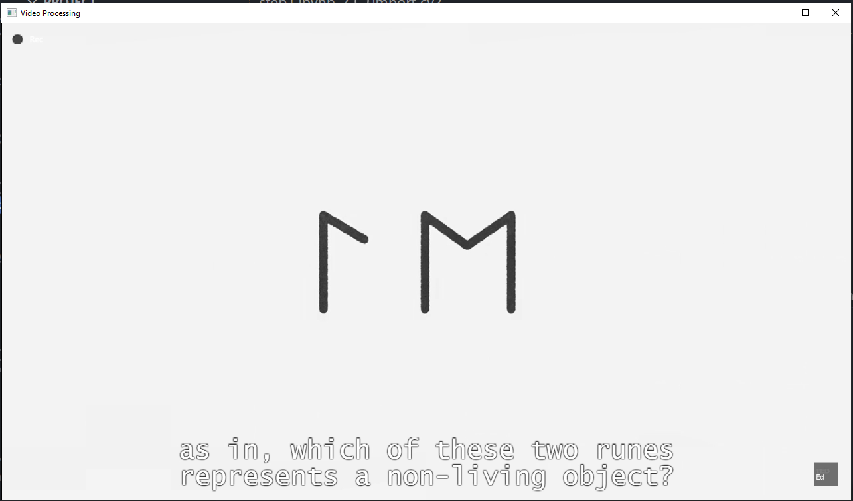
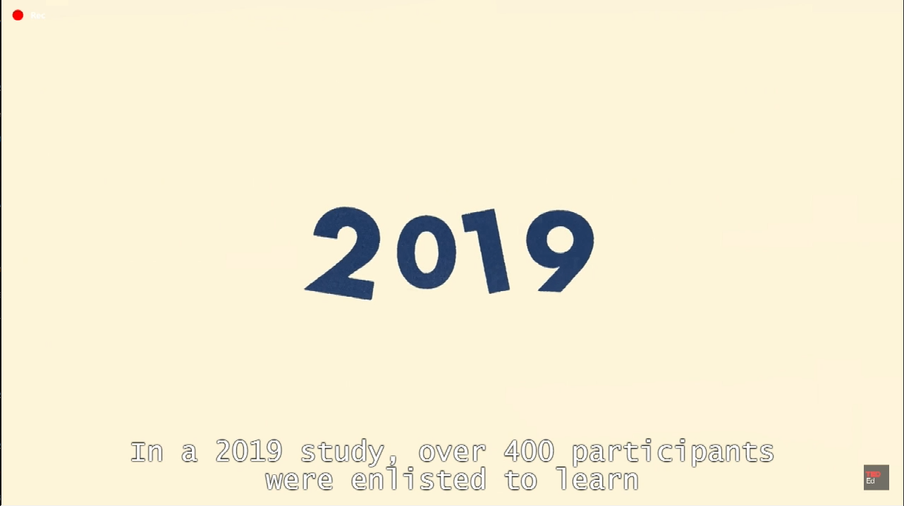
Step 1: Video Processing
Reduce expenses or replacement products we will read the video, display its frames, and apply basic preprocessing.
This example uses OpenCV in Python.

Slide 6
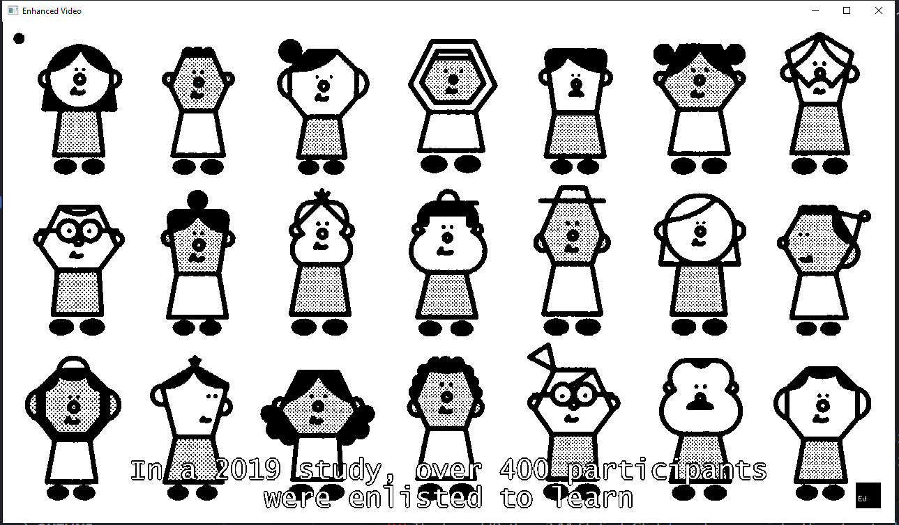
Step 2: Preprocessing & Noise Removal
In the preprocessing step, you'll apply techniques to enhance the areas containing subtitles and remove noise. Common preprocessing steps include resizing, blurring, and thresholding.

Slide 7
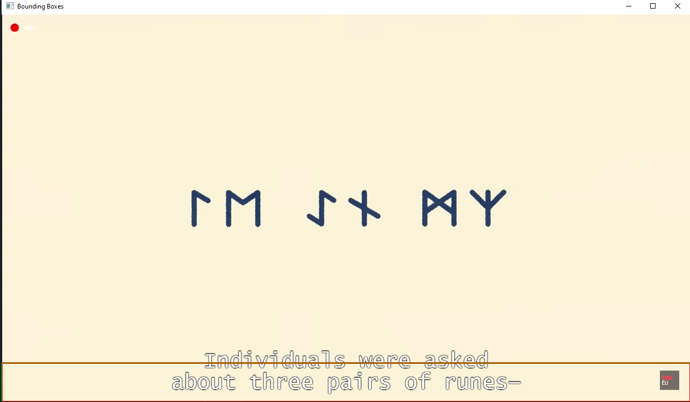
Step 3: Segmentation
Segmentation is a crucial step in detecting subtitles in a video. In this context, segmentation involves identifying regions of interest (ROIs) corresponding to subtitles. One common approach is to use contour detection to find connected components in the binary image (after thresholding).

Slide 8
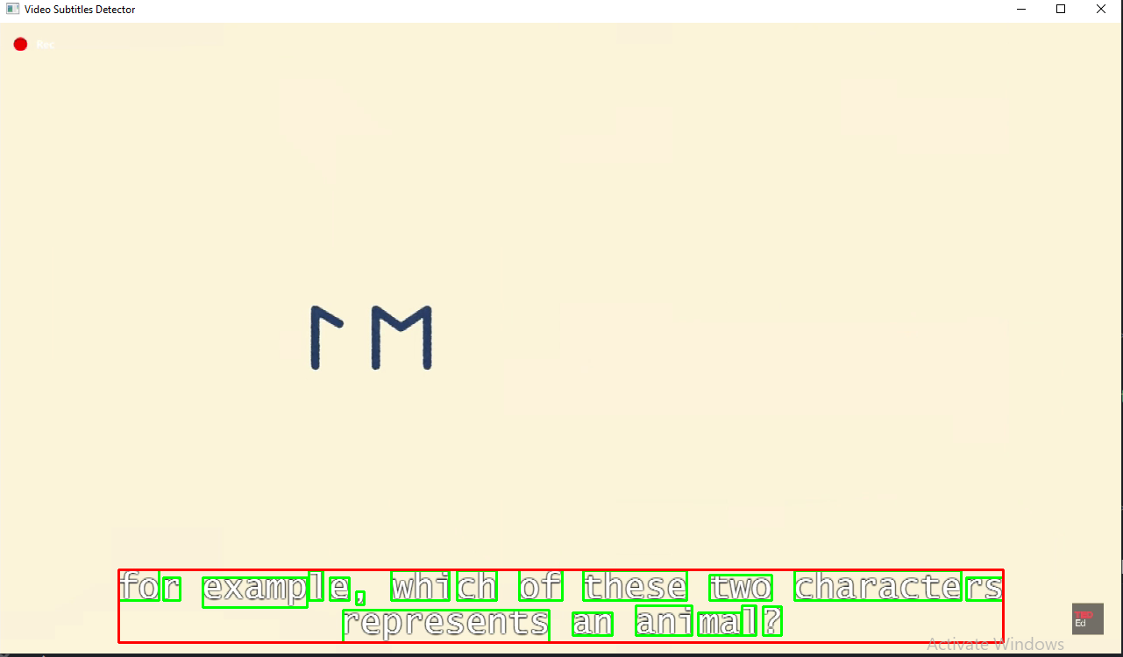
Step 4: Bounding Box Calculation
To calculate bounding boxes for subtitles, words, and characters, you need to implement logic to handle multiline subtitles and possibly perform additional processing for word and character-level bounding boxes.

Slide 9
SUMMARY
The goal of this project is to develop a subtitle detection program for videos. The program should identify and mark subtitles in red bounding boxes, with additional green bounding boxes around individual words within each subtitle.
The project provides a basic yet constrained subtitle detection system.
Accuracy is influenced by assumptions and limitations on advanced techniques.
Adjustments may be necessary based on specific video characteristics.

Slide 10
THANK YOU

